Slide 1

ILIAS TSELLOS SECURE APPLICATION DEVELOPMENT
Assessment 2

Slide 2
Introduction
In this assessment we design, develop and testing a secure software application. We must create a simple web application that has database, an authentication mechanism, and an access control mechanism. We will set it up in CI environment. We will push everything on GitLab and the we will scan our codes with SonarQube to see if any vulnerabilities are found.

Slide 3
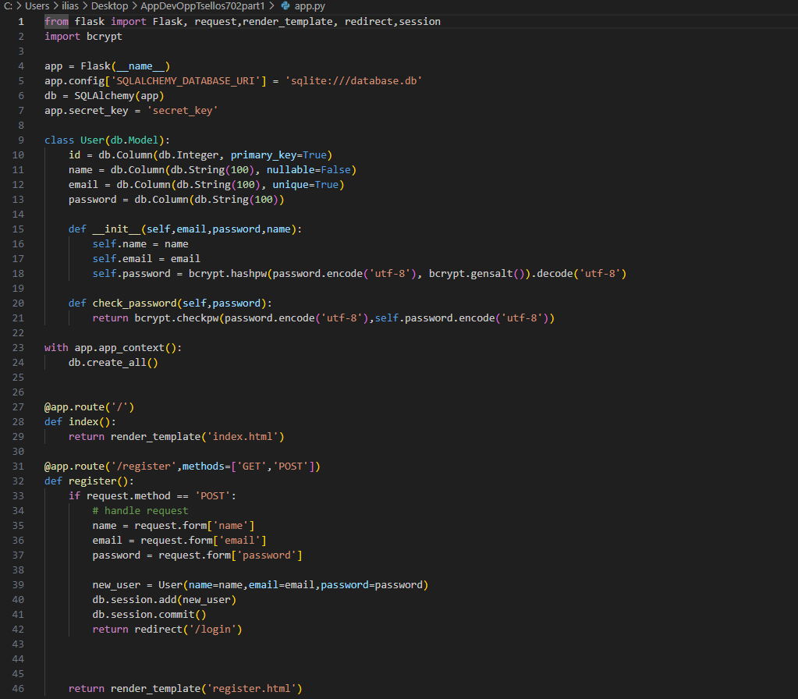
Code Explanation
This code is a basic Flask application that implements user registration, login, and logout functionalities. It utilizes SQL Alchemy for database management and bcrypt for password hashing.

Slide 4
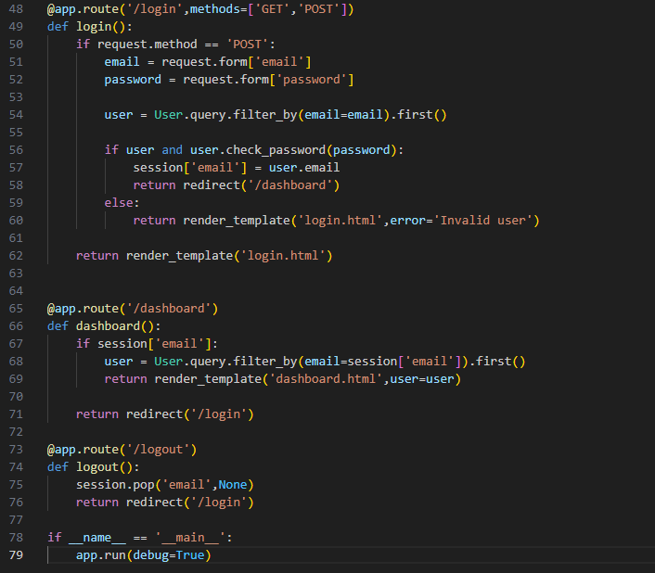
Here is the rest of the code

Slide 5
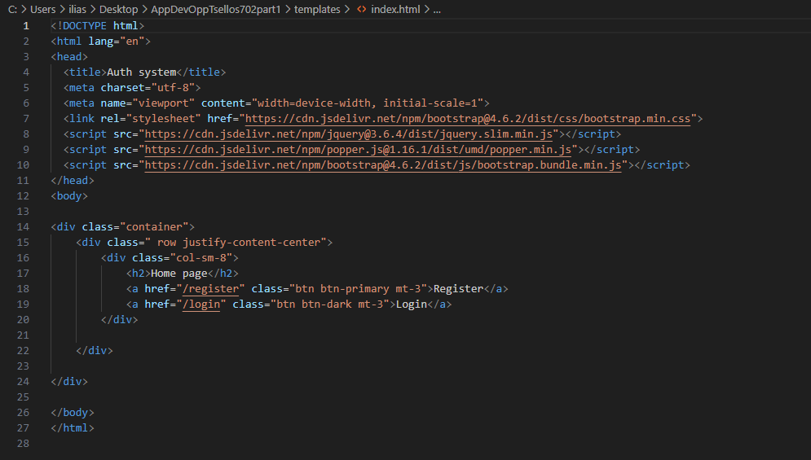
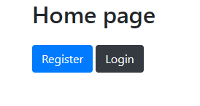
Index
Here we have an HTML of the home page. It has links to register if you are new user and a login page if you already have an account.

Slide 6
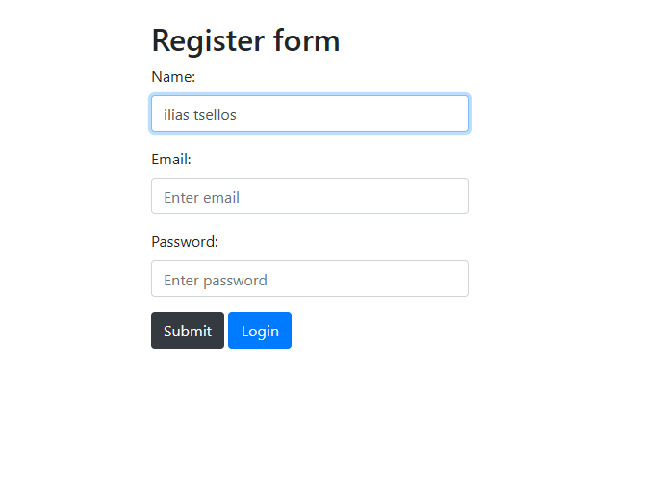
Register

Slide 7
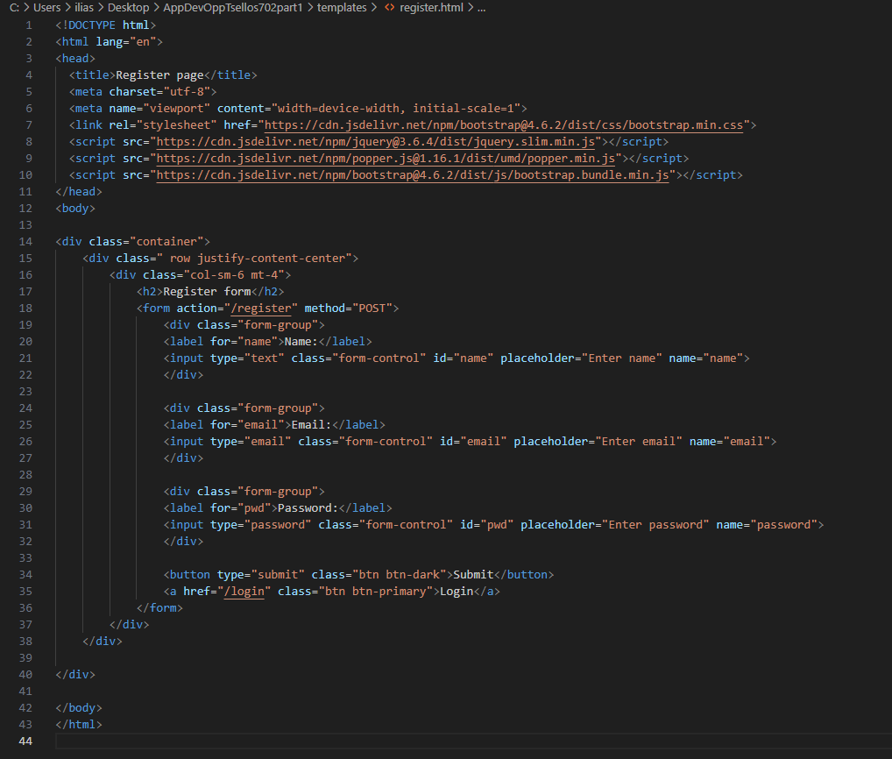
Here the HTML code is the registration page of an authentication system. It features a form where users can register by providing their name, email, and password. The page is styled using Bootstrap for a responsive layout. Users can navigate to the login page by clicking the "Login" button.

Slide 8
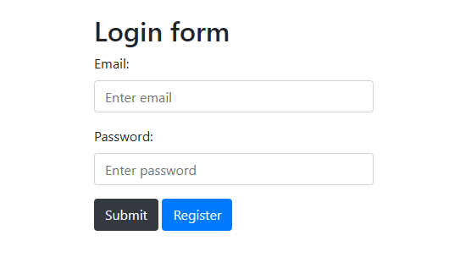
Login

Slide 9
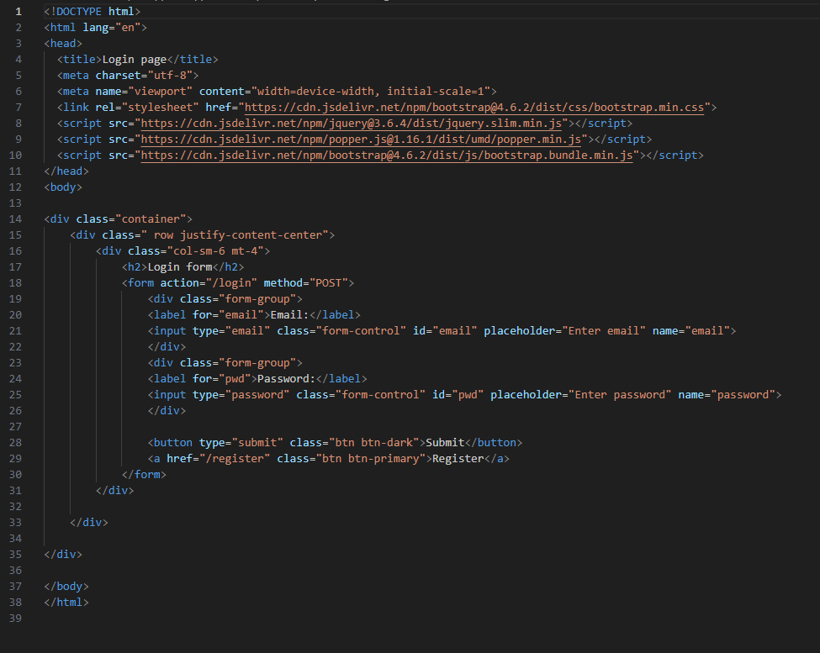
Last but not least we have login page of an authentication system where the user enter his data and it automatically searches if does exist in the database. If it does the user enters.

Slide 10
CI/CD pipeline with GitLab
After we pushed every single file such as the Python code and the HTMLs to a GitLab repository. From the Build tab we go to run a pipeline. In this case we created an yml script that is very simple and checks three stages. Those are Build, Test and Deploy. Basically, it compiles the code, runs unit tests, performs code linting and deploys the application

Slide 11
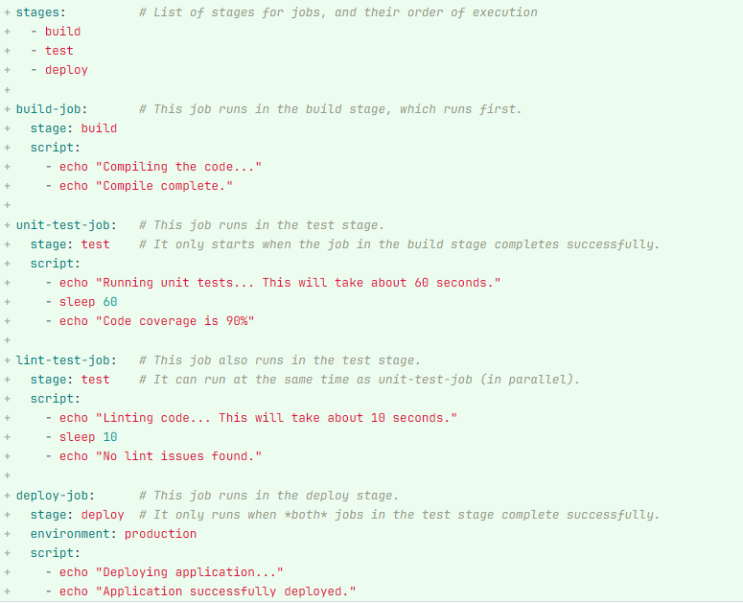
Yaml Script

Slide 12
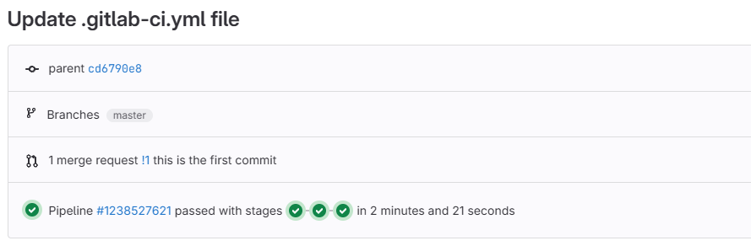
In our case those 3 stages passed, and nothing found.

Slide 13

Sonar Qube
Now for further scanning of our code to find any possible vulnerabilities we are going to use to use SonarQube.
SonarQube is an open-source platform that makes inspection of the code quality. It performs automatic reviews with static analysis of code to detect bugs, code smells, and security vulnerabilities. Last it supports most of the programming languages
Before we install SonarQube we must have Java Version 17.0 and elasticsearch

Slide 14
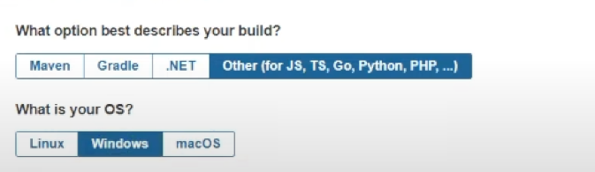
SonarQube
After we have download the SonarQube and start it service, then logged in we import our project from GitLab or even Locally. In our case we tried both cases.
After we provided our access token, we choose what we option we want we downloaded the sonar scanner
Then we took the sonar-scanner.bat file and put where the codes was and via the cmd we start the scanning.

Slide 15
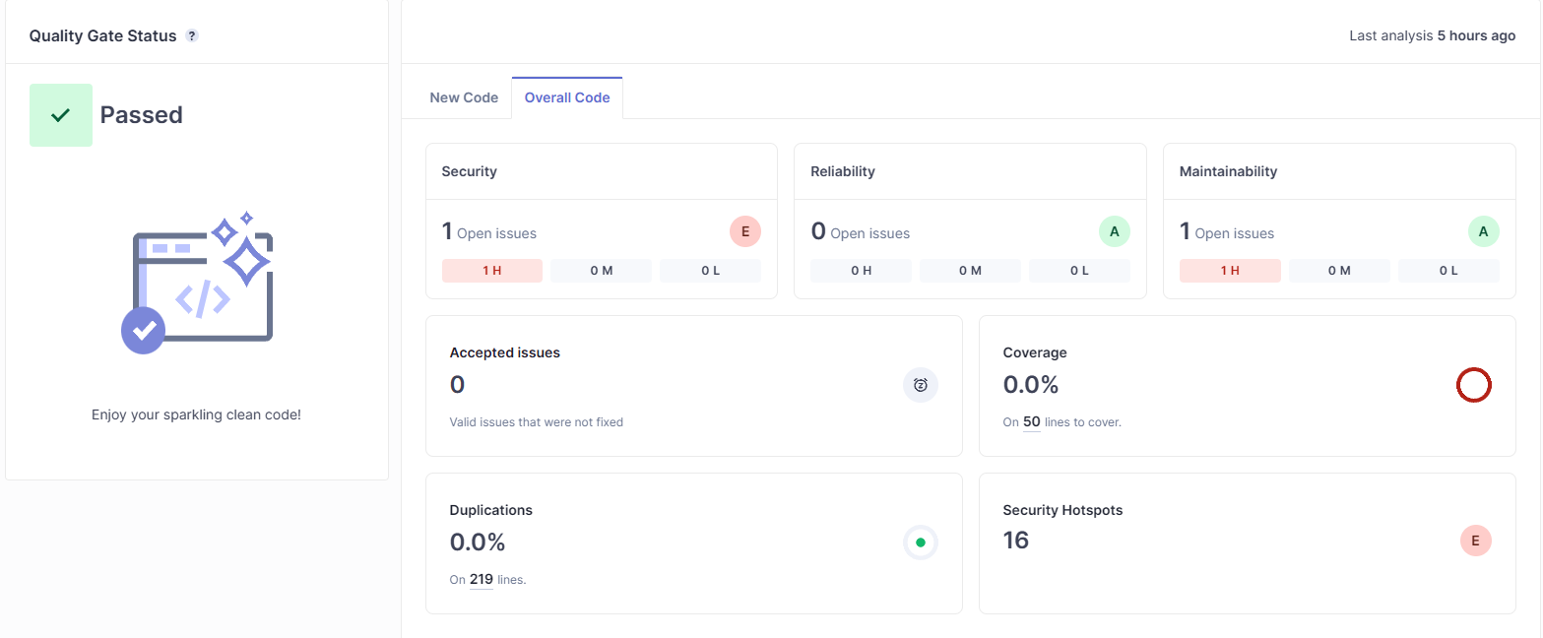
Scan Results
Here we have our results from sonar scanner and here

Slide 16
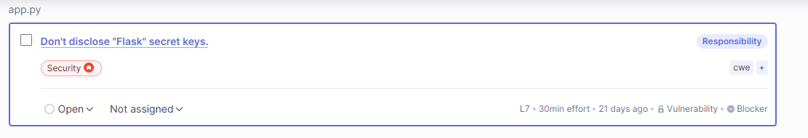
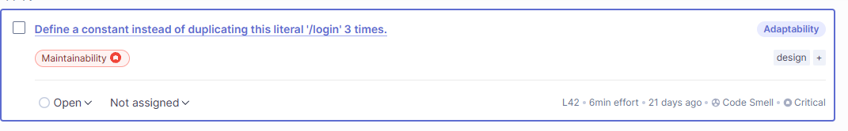
Only 2 vulnerabilities found on Maintainability and Security, we need where the problem , change our code to fix all the problems that were found, and we are ready to continue

Slide 17
REFERENCES
Championing “Secure CI-CD” with DevSecOps Using Gitlab Secure - Radiant Digital. 8 June 2021, www.radiant.digital/championing-secure-ci-cd-with-devsecops-using-gitlab-secure/. Accessed 24 Apr. 2024.
G, Babith. “Security in DevOps: Strategies for Securing the Software Development Lifecycle.” Medium, 1 Oct. 2023, medium.com/@babithganesh/security-in-devops-strategies-for-securing-the-software-development-lifecycle-d220dd7d089e. Accessed 24 Apr. 2024.
GitLab CI/CD Pipeline: A Practical Guide.” Codefresh, codefresh.io/learn/gitlab-ci/gitlab-ci-cd-pipeline-a-practical-guide/. Accessed 24 Apr. 2024.
How to Set up a Continuous Deployment Pipeline with GitLab CI/CD on Ubuntu | DigitalOcean.” Www.digitalocean.com, www.digitalocean.com/community/tutorials/how-to-set-up-a-continuous-deployment-pipeline-with-gitlab-on-ubuntu.
- Julien Vehent. Securing DevOps. Simon and Schuster, 20 Aug. 2018.
Qualys Web App Scanning Connector for Azure DevOps User Guide Version 1.2.2. 2023.
- SonarQube Tutorial: Mastering Code Quality with Static Analysis.” Www.upgrad.com, www.upgrad.com/tutorials/software-engineering/software-key- tutorial/sonarqube-in-java/. Accessed 24 Apr. 2024.
- Static Code Analysis: Everything You Need to Know.” Blog.codacy.com, 11 Oct. 2023, blog.codacy.com/static-code-analysis.

Slide 18
REFERENCES
Stay ahead of Threats with DevOps Security Best Practices | TechTarget.” IT Operations, www.techtarget.com/searchitoperations/tip/Stay-ahead-of-threats-with-DevOps-security-best-practices. Accessed 24 Apr. 2024.
What Is the .Gitlab-Ci.yml File and How to Work with It.” Codefresh, codefresh.io/learn/gitlab-ci/what-is-the-gitlab-ci-yml-file-and-how-to-work-with-it/.
Wilson, Glenn. DevSecOps: A Leader’s Guide to Producing Secure Software without Compromising Flow, Feedback and Continuous Improvement. Amazon, Rethink Press, 10 Dec. 2020, www.amazon.com/DevSecOps-producing-compromising-continuous-improvement/dp/1781335028. Accessed 24 Apr. 2024.
Yazir, Onur. “SonarQube Tutorial.” Software Test Academy, 28 Jan. 2016, www.swtestacademy.com/sonarqube-tutorial/.

Slide 19
THANKS FOR YOUR ATTENTION

